Slide 1



EXXON BOOTCATHON 2024
Hyperlube
ExxonMobil
FUEL YOUR SALES WITH OUR LUBE.

Slide 2
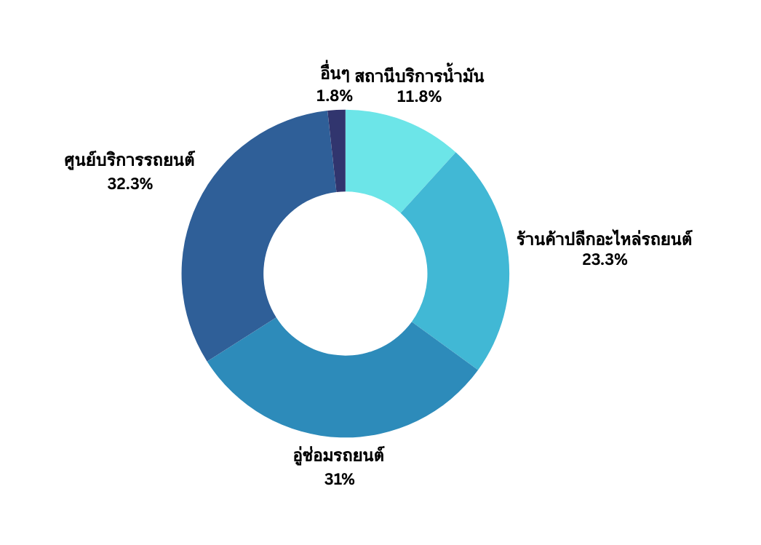
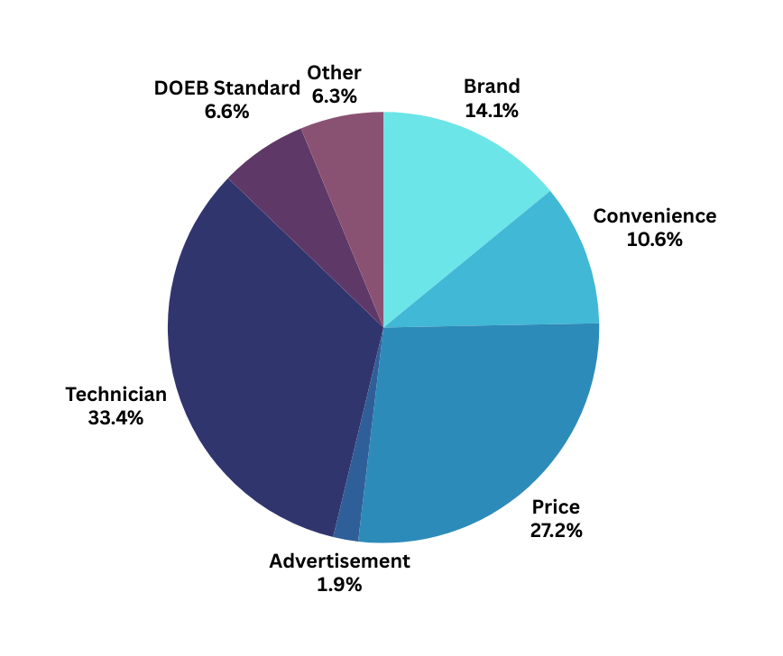
Customer Analysis
Purchasing Channel
Reason of Choice
Proportion of gasoline lubricant place of purchase
(Data from research survey with the total participant of 200 people)
The proportion of factor which affect the gasoline lubricant purchase decision
(Data from research survey with the total participant of 320 people)
Source: A comparison of purchasing decision of gasoline engine lubricants for personal cars between semi-synthetic type and synthetic type in Bangkok (2015)
Situation Analysis
Analysis Tool
Solution
Impact
1

Slide 3
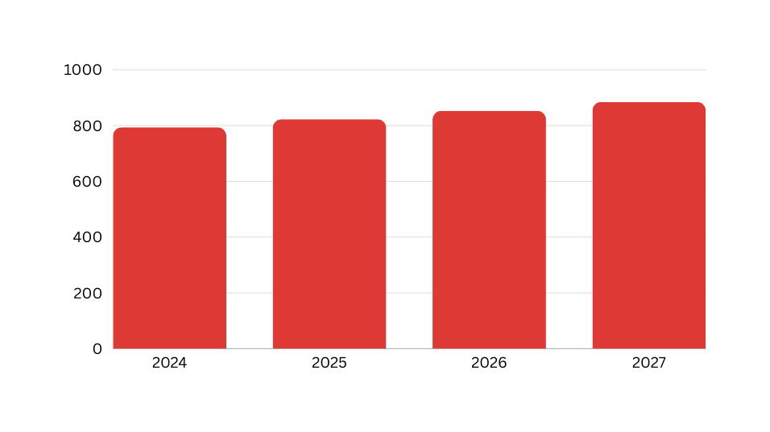
Market Analysis
Market Size
Market Growth
Thailand total lubricant market size
Thailand Total Lubricant Market
794.2 M
A type of services that charges user based on the quantity used at fixed time interval. For example, utility bills.
359.9 M
Thailand Automotive Lubricant Market
Gasoline Lubricant Market
359.9 M
The market grow from 794 million liter in 2024 to 885 million liter to 2027
The compound annual growth average (CAGR) from 2024 to 2027 is 3.7%
The market driver is awareness of consumer of better quality of fully synthetic oil
Figures are presented in millions of liters
The datas are from 2023
Source: Ken Research, Motor Intelligence
Situation Analysis
Analysis Tool
Solution
Impact
2

Slide 4
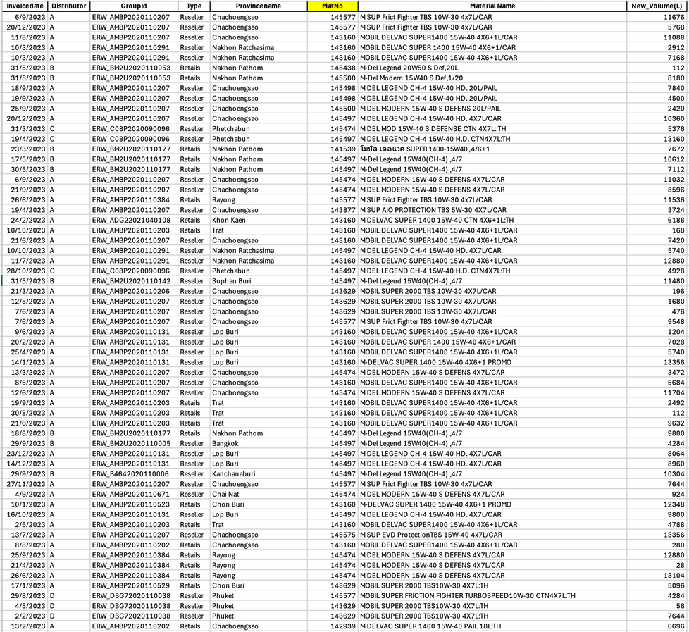
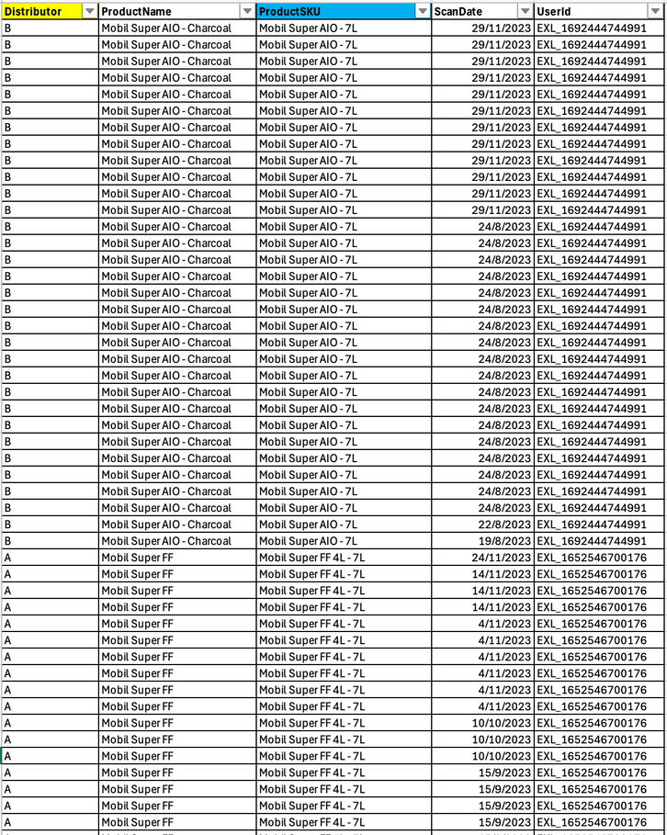

Current Data Situation
MER Dataset
MRW Dataset
Situation Analysis
Analysis Tool
Solution
Impact
3

Slide 5



Current Data Situation
RFM/Tier Analysis
Churn Prediction
R
ecency
Understanding why customers stop using a company's products / services
How recently a customer made a purchase.
F
requency
Identification of At-Risk Customers
How often a customer makes a purchase.
M
onetary
Total points a customer has earned
Personalized Retention Strategies
RFM Scores
identifies similar groups
Situation Analysis
Analysis Tool
Solution
Impact
4

Slide 6
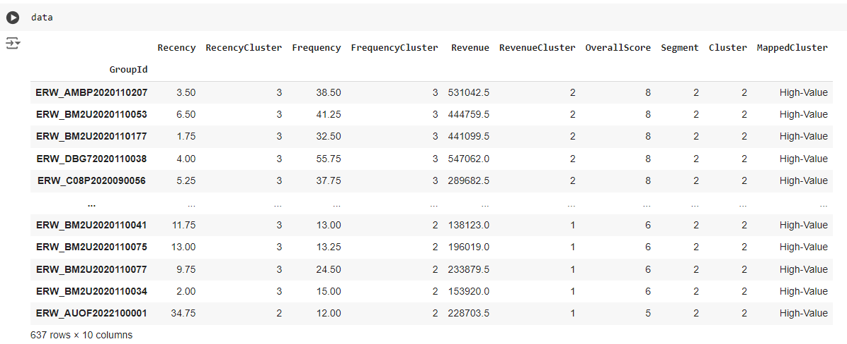
Workshop & Retail Solution: Ranking System
RFM/Tier Analysis
Segment next month's customers into High, Mid, and Low tiers to enable targeted marketing strategies.
Feature Based on RFM Score
Recency
RecencyCluster (K-Means)
Frequency
FrequencyCluster (K-Means)
Monetary
MonetaryCluster (K-Means)
OverallScore (RFM Score)
Result of Tier Analysis
Tier Segment (High/Mid/Low)
Analysis Model Used: XGBoost (for Group Clustering), 99% Segment Accuracy
Situation Analysis
Analysis Tool
Solution
Impact
5

Slide 7
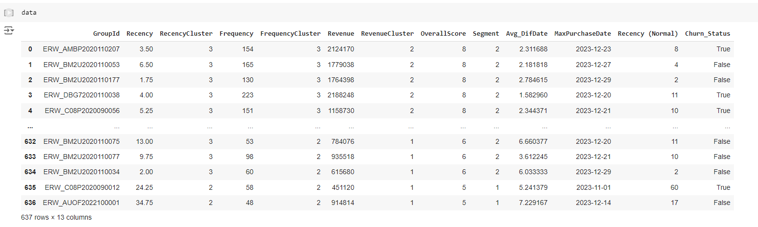
Workshop & Retail Solution: Churn Prevention
Churn Prediction
Predict Churn Customer and using Marketing Incentive on the Target to prevent Churn.
Feature Based on RFM Score
Recency
Frequency
Monetary
OverallScore (RFM Score)
Average Transaction Time
Elapsed Time Since Latest Transaction
Result of Churn Prediction
Next month Churn Status
(Risk of Churn/Not Risk of Churn)
Prediction Model Used: XGBoost (for Next Month Prediction), 76% ML Model Accuracy
Situation Analysis
Analysis Tool
Solution
Impact
6

Slide 8
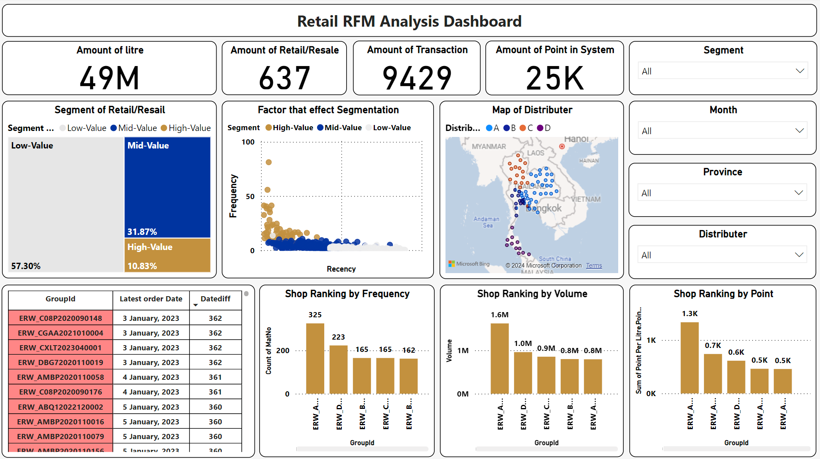
RFM Analysis Dashboard
Situation Analysis
Analysis Tool
Solution
Impact
7

Slide 9
RFM Analysis Dashboard
Situation Analysis
Analysis Tool
Solution
Impact
7

Slide 10
RFM Analysis Dashboard
Situation Analysis
Analysis Tool
Solution
Impact
7

Slide 11
RFM Analysis Dashboard
Situation Analysis
Analysis Tool
Solution
Impact
7

Slide 12
RFM Analysis Dashboard
Situation Analysis
Analysis Tool
Solution
Impact
7

Slide 13
RFM Analysis Dashboard
Situation Analysis
Analysis Tool
Solution
Impact
7

Slide 14
RFM Analysis Dashboard
Situation Analysis
Analysis Tool
Solution
Impact
7

Slide 15
RFM Analysis Dashboard
Situation Analysis
Analysis Tool
Solution
Impact
7

Slide 16
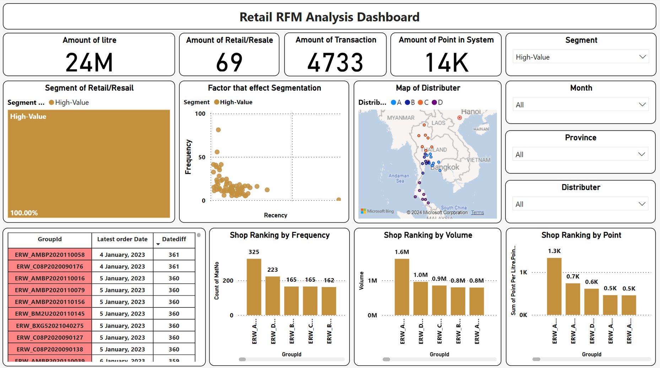
RFM Analysis Dashboard
Situation Analysis
Analysis Tool
Solution
Impact
7

Slide 17
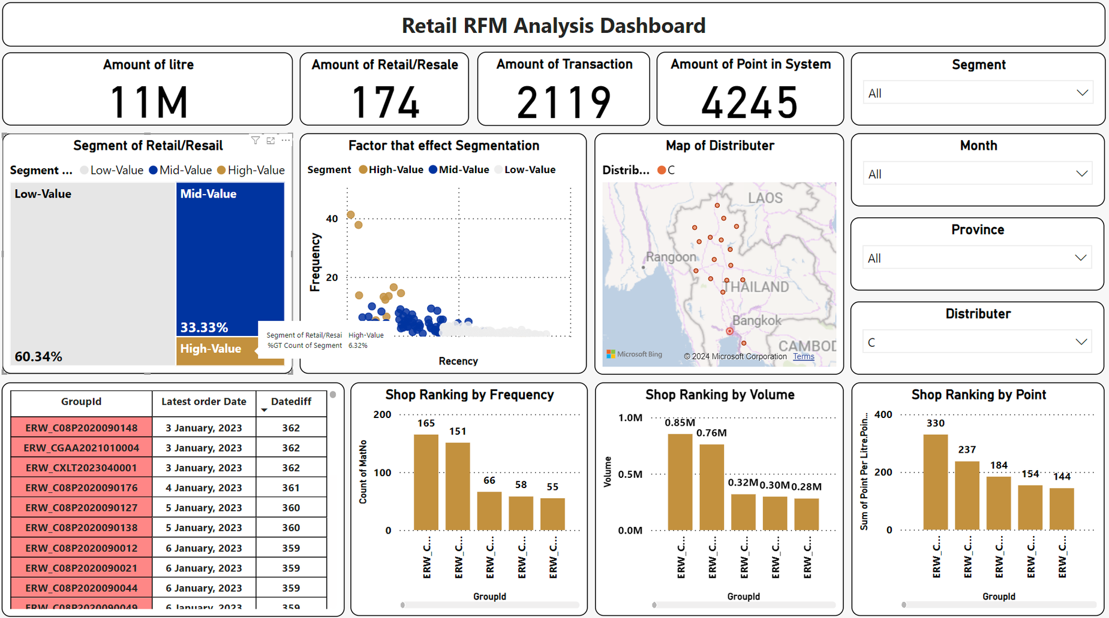
RFM Analysis Dashboard
Situation Analysis
Analysis Tool
Solution
Impact
7

Slide 18
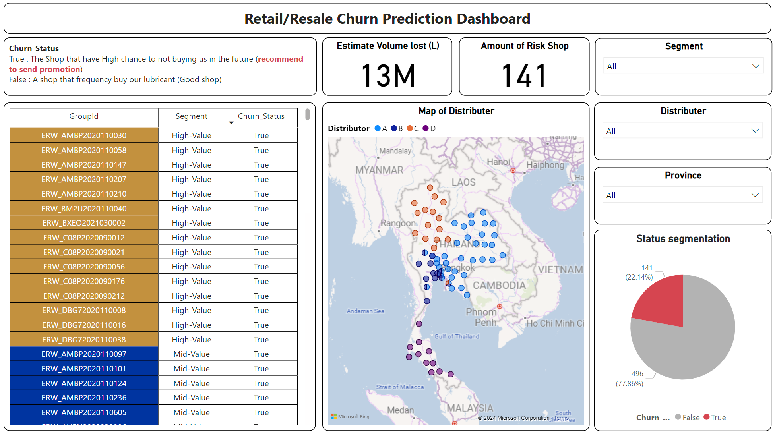
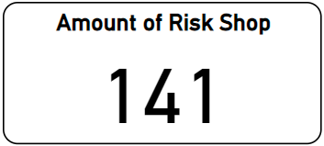
Churn Prediction Dashboard
Situation Analysis
Analysis Tool
Solution
Impact
8

Slide 19
Churn Prediction Dashboard
Situation Analysis
Analysis Tool
Solution
Impact
8

Slide 20
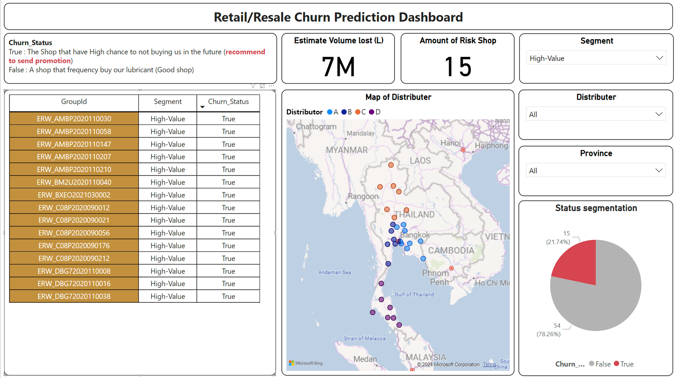
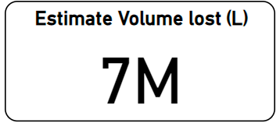
Churn Prediction Dashboard
Situation Analysis
Analysis Tool
Solution
Impact
8

Slide 21
Churn Prediction Dashboard
High Life Time Value Segment
Churned Customer
72M $
~
*Reference from Mobil Super $10.3 / Liter
Situation Analysis
Analysis Tool
Solution
Impact
8

Slide 22
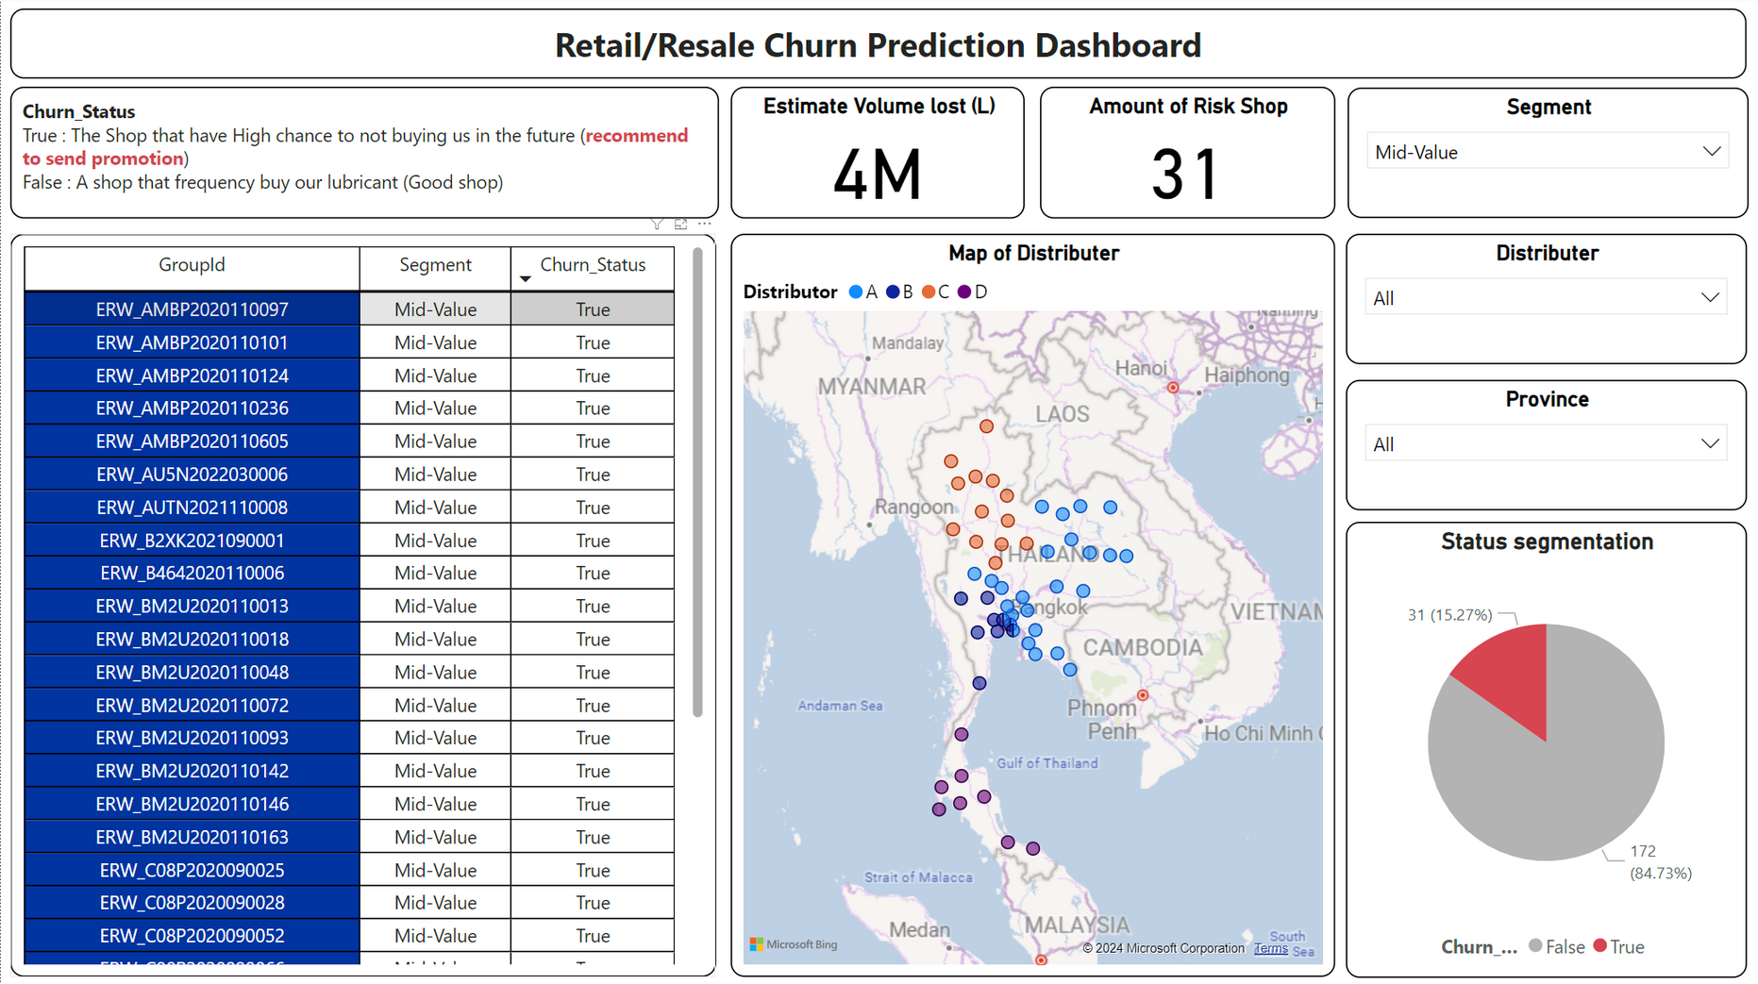
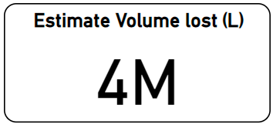
Churn Prediction Dashboard
Mid Life Time Value Segment
Churned Customer
41M $
~
*Reference from Mobil Super $10.3 / Liter
Situation Analysis
Analysis Tool
Solution
Impact
8

Slide 23
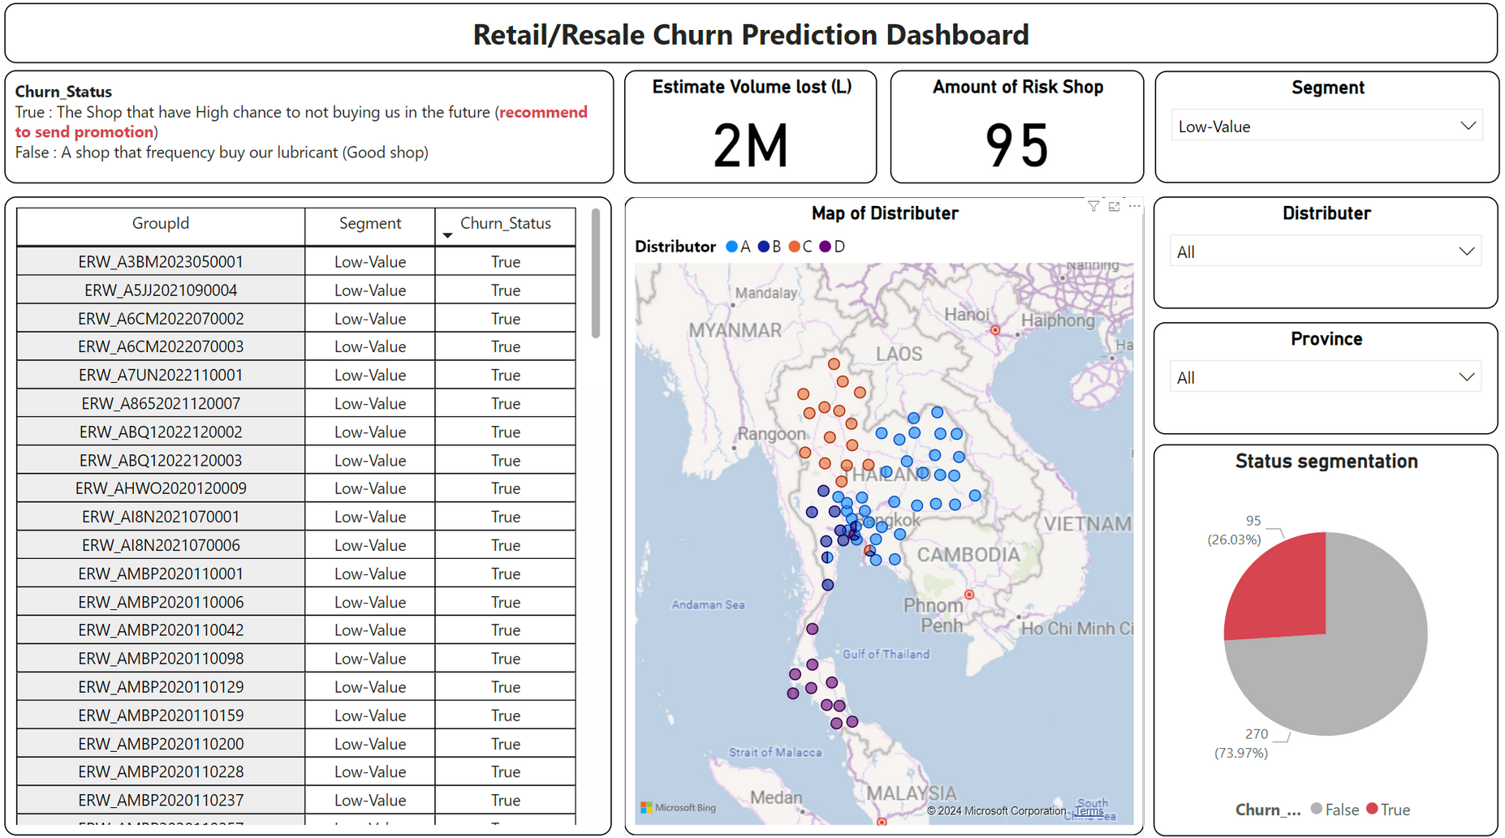
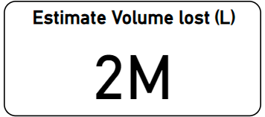
Churn Prediction Dashboard
Low Life Time Value Segment
Churned Customer
20M $
~
*Reference from Mobil Super $10.3 / Liter
Situation Analysis
Analysis Tool
Solution
Impact
8

Slide 24
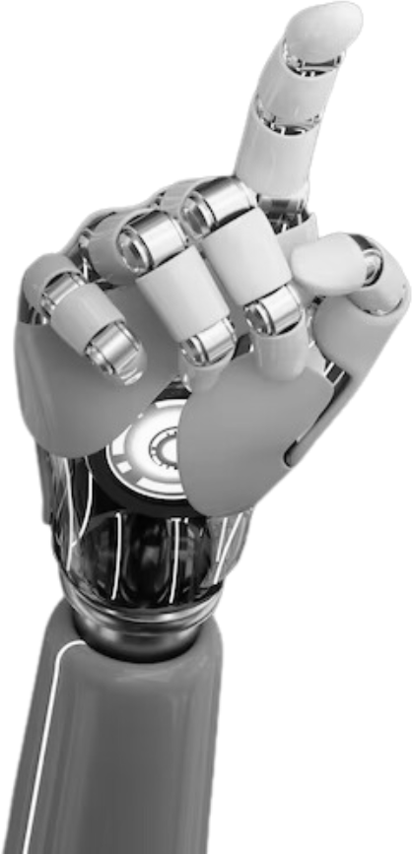
USE CASE

Slide 25
RFM Analysis Dashboard
203
365
69
Situation Analysis
Analysis Tool
Solution
Impact
9

Slide 26





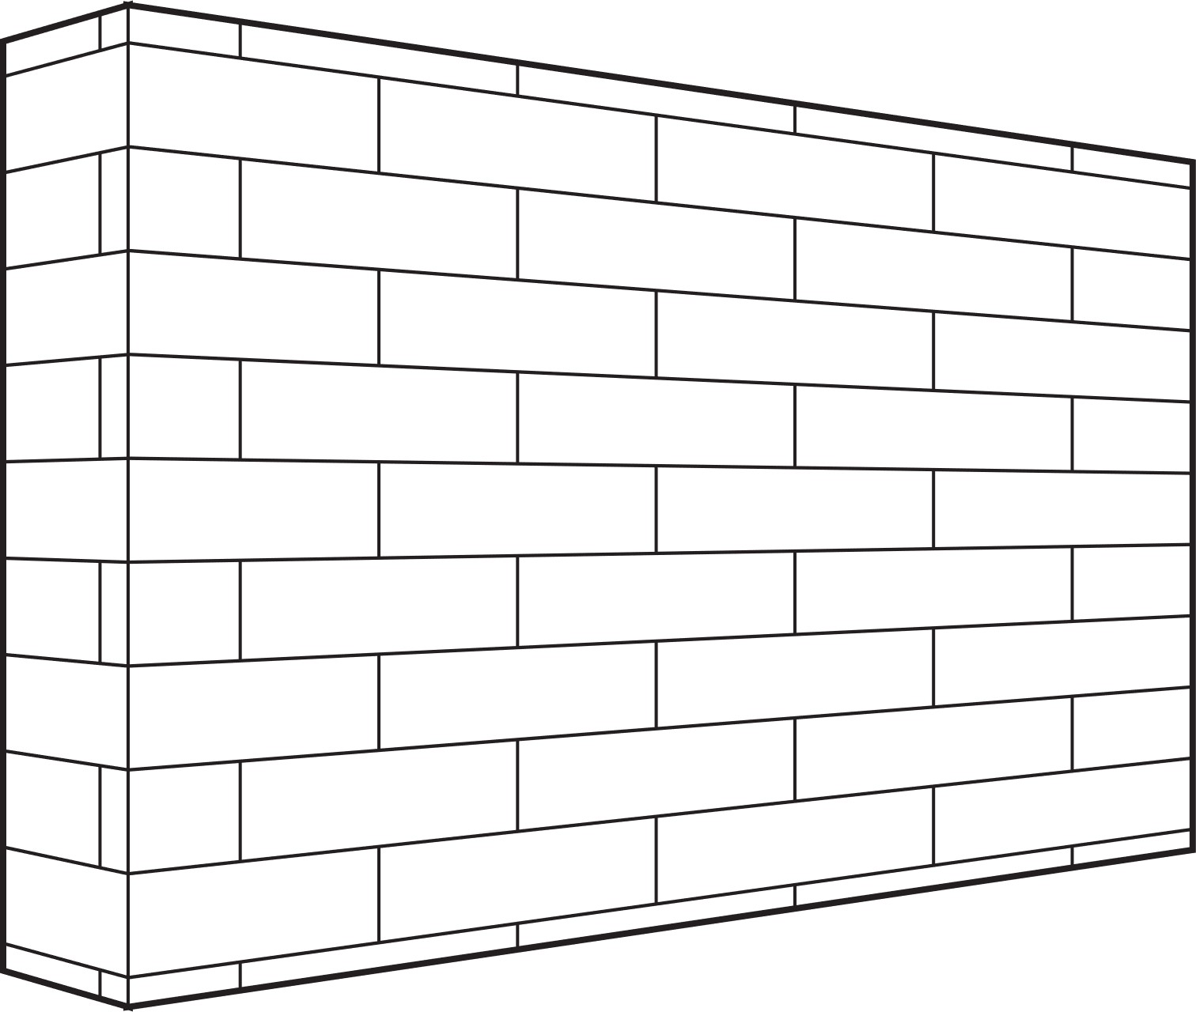


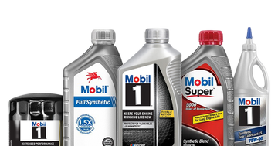



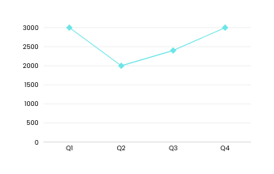
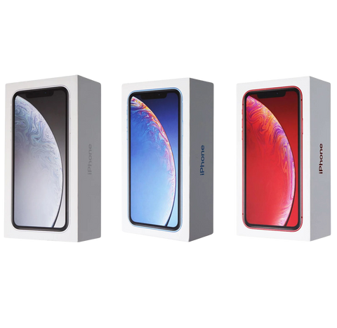



Workshop & Retail Solution: Ranking System
Tiered Loyalty Program
Growth Opportunity Segment
1
2
3
4
5
1 Point
5 Point
10 Point
20 Point
30 Point
Mid LTV Wall
Prime Value Segment
9
8
7
6
Retail Internal Dashboard
Retail A
300 Point
200 Point
150 Point
100 Point
Point
#310 / 637
High LTV Wall
Growth Opportunity Segment
You have potential to promote to Mid-Rank!
Elite Customer Segment
10
11
12
13
Points Received
500 Point
1000 Point
2000 Point
5000 Point
Quarter in 2023
You are here!
10
Situation Analysis
Analysis Tool
Solution
Impact
11

Slide 27
Workshop & Retail Solution: Churn Prevention
High LTV
(15 Shop)
Mid LTV
(31 Shop)
Low LTV
(95 Shop)
Situation Analysis
Analysis Tool
Solution
Impact
11

Slide 28
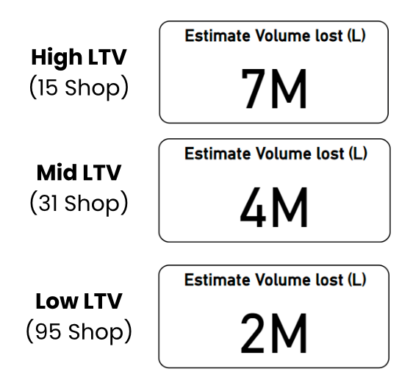

Workshop & Retail Solution: Churn Prevention
Give out incentives tailored to each customer segment
Generate positive return on ad spend (ROAS)
Situation Analysis
Analysis Tool
Solution
Impact
12

Slide 29
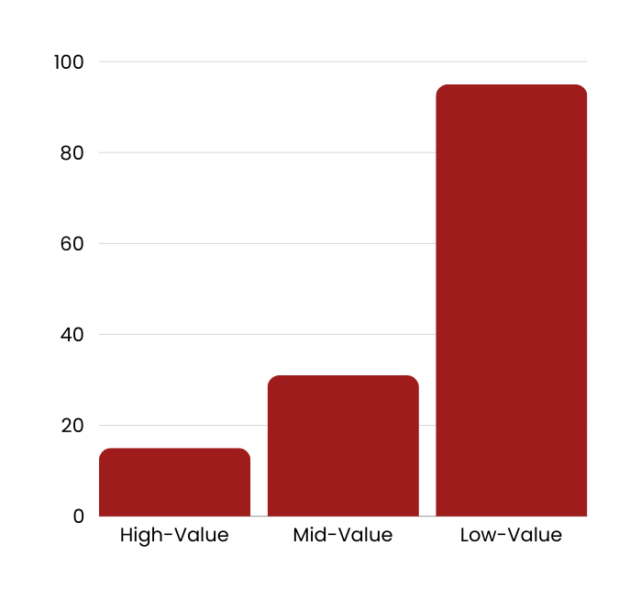
Workshop & Retail Solution: Churn Prevention
“Acquiring a new customer can cost five times more than retaining an existing customer?”
95
22.1%
Possible Churn Retail
31
Risk of Churn in Total
(141 from 637)
15
Source: OutboundEngine
Situation Analysis
Analysis Tool
Solution
Impact
13

Slide 30

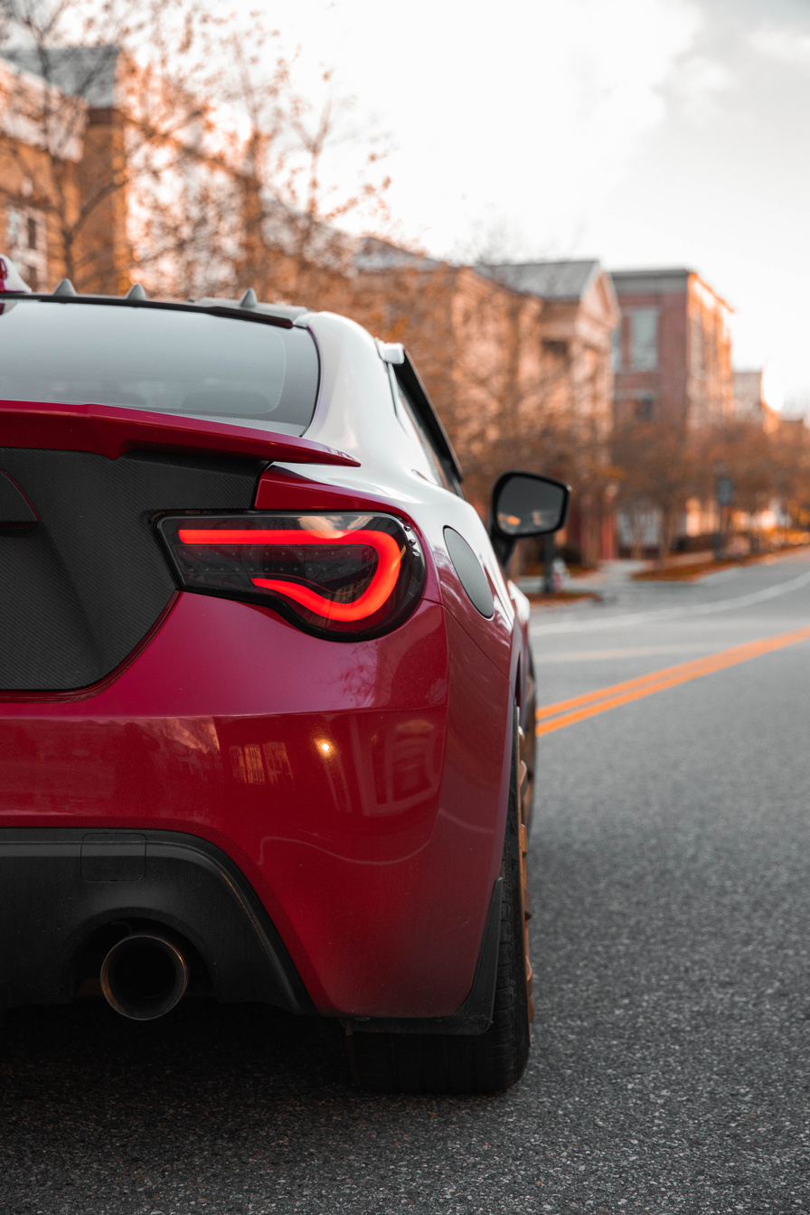


WHAT ABOUT OUR END-CUSTOMER,
THE DRIVER

Slide 31
Driver Solution: Marketing Incentive on Driver
the driver has to replace their car Lubricant once in 6 month time period
Car Lubricant product nature
86% of driver switches brand
Situation Analysis
Analysis Tool
Solution
Impact
14

Slide 32
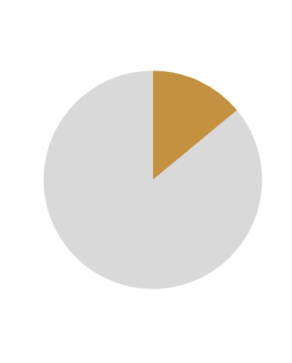
Driver Solution: Marketing Incentive on Driver
the driver has to replace their car Lubricant once in 6 month time period
Car Lubricant product nature
86% of driver switches brand
If we able to convert 86% of the customer who purchase their second car lubricant
75%
ExxonMobil’s total sales will Increase by
Situation Analysis
Analysis Tool
Solution
Impact
15

Slide 33
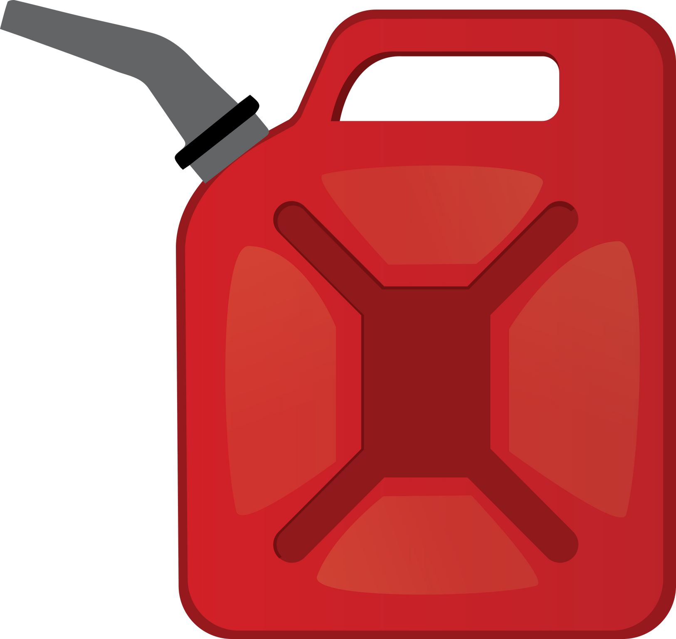



Driver Solution: Marketing Incentive on Driver
“To secure the customer from switching car Lubricant brand”
Bundling Promotion
get X% off when purchase for the 2nd time
Situation Analysis
Analysis Tool
Solution
Impact
16

Slide 34
Driver Solution: Marketing Incentive on Driver
Car Lubricant product nature
Low profit margin
Dynamic Bundling Discount Design based on Sales Analytic
marketing incentive on driver
Prevent Low Profit Margin
Situation Analysis
Analysis Tool
Solution
Impact
17

Slide 35
Driver Solution: Marketing Incentive on Driver
Car Lubricant product nature
Low profit margin
Dynamic Bundling Discount Design based on Sales Analytic
marketing incentive on driver
Prevent Low Profit Margin
Situation Analysis
Analysis Tool
Solution
Impact
18

Slide 36

Driver Solution: Marketing Incentive on Driver
Bundling Promotion : Discount design
Utilizing past data
predict future promotion-sales relation
Example Case
Assume : coefficient of promotion = 2.5%
find Maximum Profit-promotion point
5% Discount (10% discount on 2nd purchase) | 5% Discount (10% discount on 2nd purchase) | 5% Discount (10% discount on 2nd purchase)
Quantity | Sale Price | Revenue
215,656.00 | 2,000.00 | 431,312,000.00
242,613.00 | 1,900.00 | 460,964,700.00
Revenue Increased by Approx. 7%
Revenue Increased by Approx.
30M
Logistics required : Internal sales data
Situation Analysis
Analysis Tool
Solution
Impact
19

Slide 37
Driver Solution: Marketing Incentive on Driver
Bundling Promotion : Discount design
Utilizing past data
predict future promotion-sales relation
Example Case
Assume : coefficient of promotion = 2.5%
find Maximum Profit-promotion point
5% Discount (10% discount on 2nd purchase) | 5% Discount (10% discount on 2nd purchase) | 5% Discount (10% discount on 2nd purchase)
Quantity | Sale Price | Revenue
215,656.00 | 2,000.00 | 431,312,000.00
242,613.00 | 1,900.00 | 460,964,700.00
Revenue Increased by Approx. 7%
Revenue Increased by Approx.
30M
Logistics required : Internal sales data
Situation Analysis
Analysis Tool
Solution
Impact
19

Slide 38
Implementation Timeline
2024
2025
Q3
Q4
Q1
Q2
Q3
Q4
Data Verification
Dashboard & Line OA Development
Pre - Launch
Prototype testing
System implementation
Launch
Collect feedback
Post - Launch
Refine system & ML Model
Expand coverage
Scaling
Monitor and maintain
Situation Analysis
Analysis Tool
Solution
Impact
20

Slide 39






Future Execution
The more information the
BETTER
Workshop details
End-Customer details
Challenges
Size
Amount of car can handle
Type of car
Car type
Age
Location
Favorite lubricant
Favorite Garage
Gathering Essential Data
Extract Data Insight
1. Enhance Ranking System
2. Enhance Churn Prediction
Classify each retail/garage into three size (separate by entrance rate and province) before start Ranking System.
Behavioral Analysis
Hyper-Personalization
Customer Journey Mapping
High
Mid
Low
3. Develop Sales Uplift Prediction
L
Predict the incremental impact and Uplift Score on sales of a marketing campaign or promotional activity.
M
Assess the effectiveness of past campaigns
Adjust marketing strategies and resource allocation
S
Situation Analysis
Analysis Tool
Solution
Impact
21

Slide 40



Impact
Increase ExxonMobil Sale
Reduce cost of acquisition
Gain End Customer Data
Increase in revenue by 30M
Reduce CAC by 7-13%
Get valuable customer data to drive demand
Situation Analysis
Analysis Tool
Solution
Impact
22

Slide 41
EXXON BOOTCATHON 2024
Hyperlube
ExxonMobil
FUEL YOUR SALES WITH OUR LUBE.

Slide 42
Appendix

Slide 43

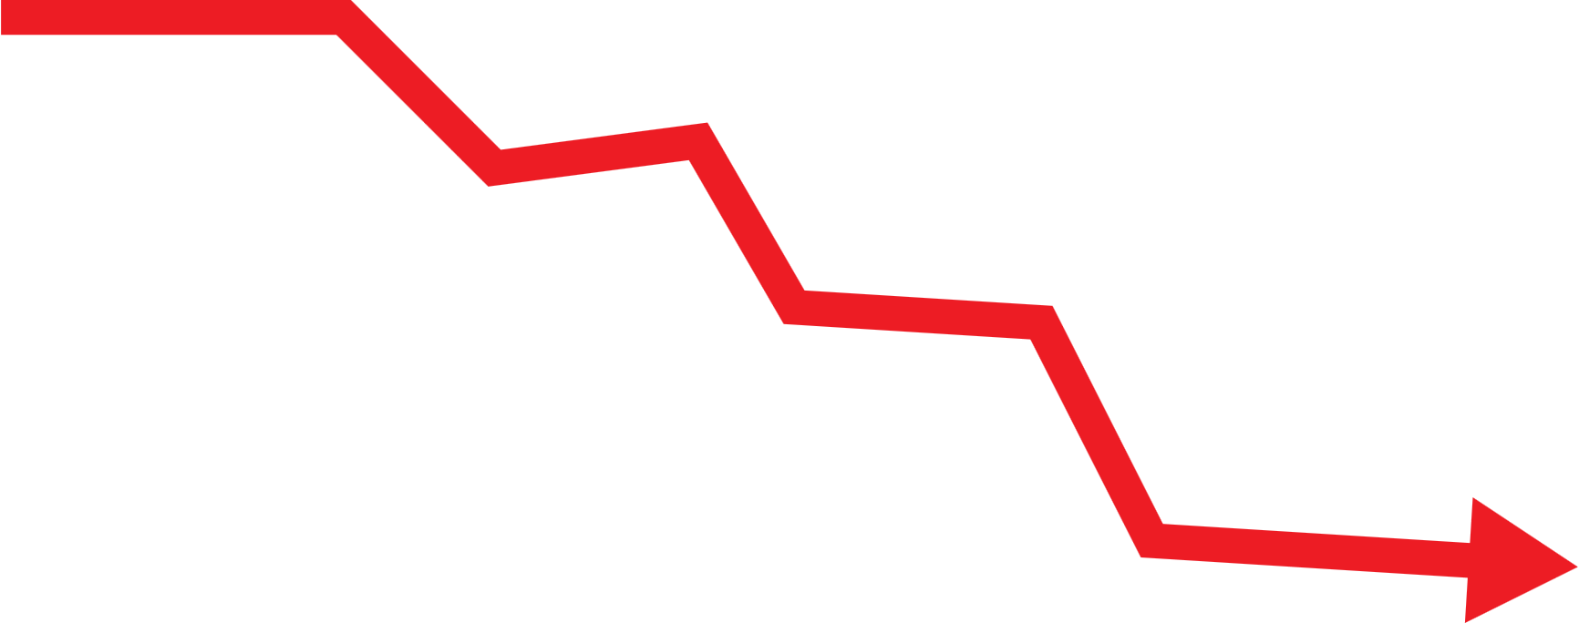
Pain Points from Data Insight
There are 57.3% of the
Low-Value rank
There are 141 Customers at
Risk of Churn in Every Rank
13M
Approximately
Liter lost.
Situation Analysis
Analysis Tool
Solution
Impact
1

Slide 44
Driver Solution: Marketing Incentive on Driver
Bundling Promotion : Incentive Setting
Logistics required : Internal sales data
Utilizing past data to find optimal coefficient of promotion
%Coeff | Discount | rate Discount | Q percent | Quantity Incentive | rate Q incentive
2.5 | 1% | 0.99 | 2.50% | 0.025 | 1.025
2.5 | 2% | 0.98 | 5.00% | 0.05 | 1.05
2.5 | 3% | 0.97 | 7.50% | 0.075 | 1.075
2.5 | 4% | 0.96 | 10.00% | 0.1 | 1.1
2.5 | 5% | 0.95 | 12.50% | 0.125 | 1.125
2.5 | 6% | 0.94 | 15.00% | 0.15 | 1.15
2.5 | 7% | 0.93 | 17.50% | 0.175 | 1.175
2.5 | 8% | 0.92 | 20.00% | 0.2 | 1.2
2.5 | 9% | 0.91 | 22.50% | 0.225 | 1.225
2.5 | 10% | 0.9 | 25.00% | 0.25 | 1.25
predict future promotion-sales relation
Able to find Maximum Profit-promotion point
Example Case
Assume : coefficient of promotion = 2.5%
5% Discount (10% discount on 2nd purchase) | 5% Discount (10% discount on 2nd purchase) | 5% Discount (10% discount on 2nd purchase)
Quantity | Sale Price | Revenue
215,656.00 | 2,000.00 | 431,312,000.00
242,613.00 | 1,900.00 | 460,964,700.00
Revenue Increased Appox. 30M
when discount x% demand will increase by “coefficient of promotion”%
Situation Analysis
Analysis Tool
Solution
Impact
2

Slide 45
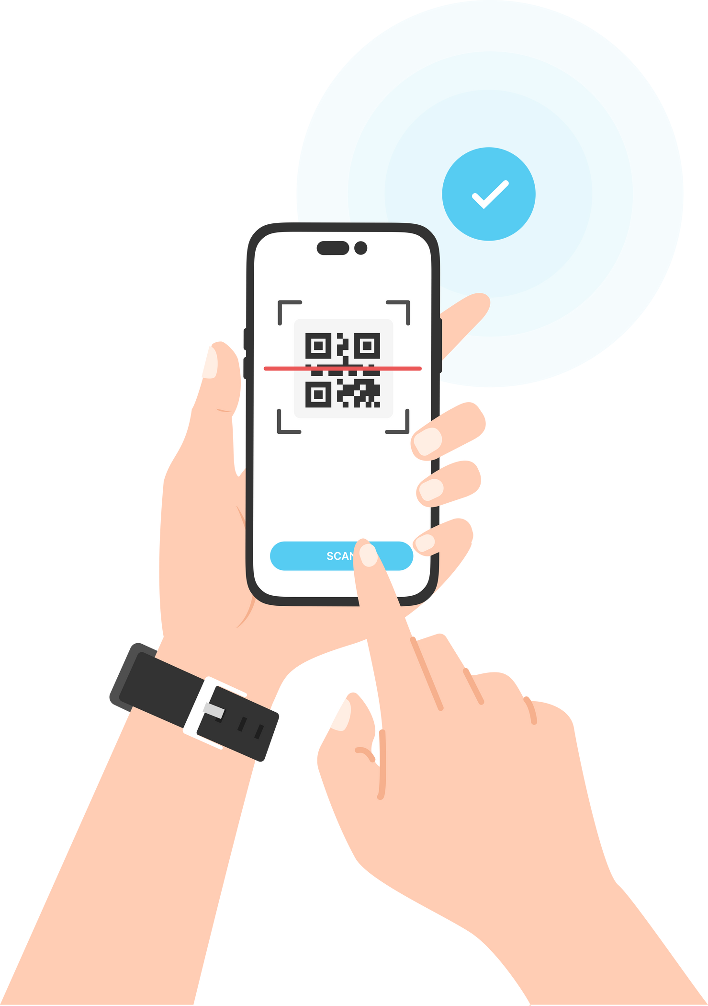

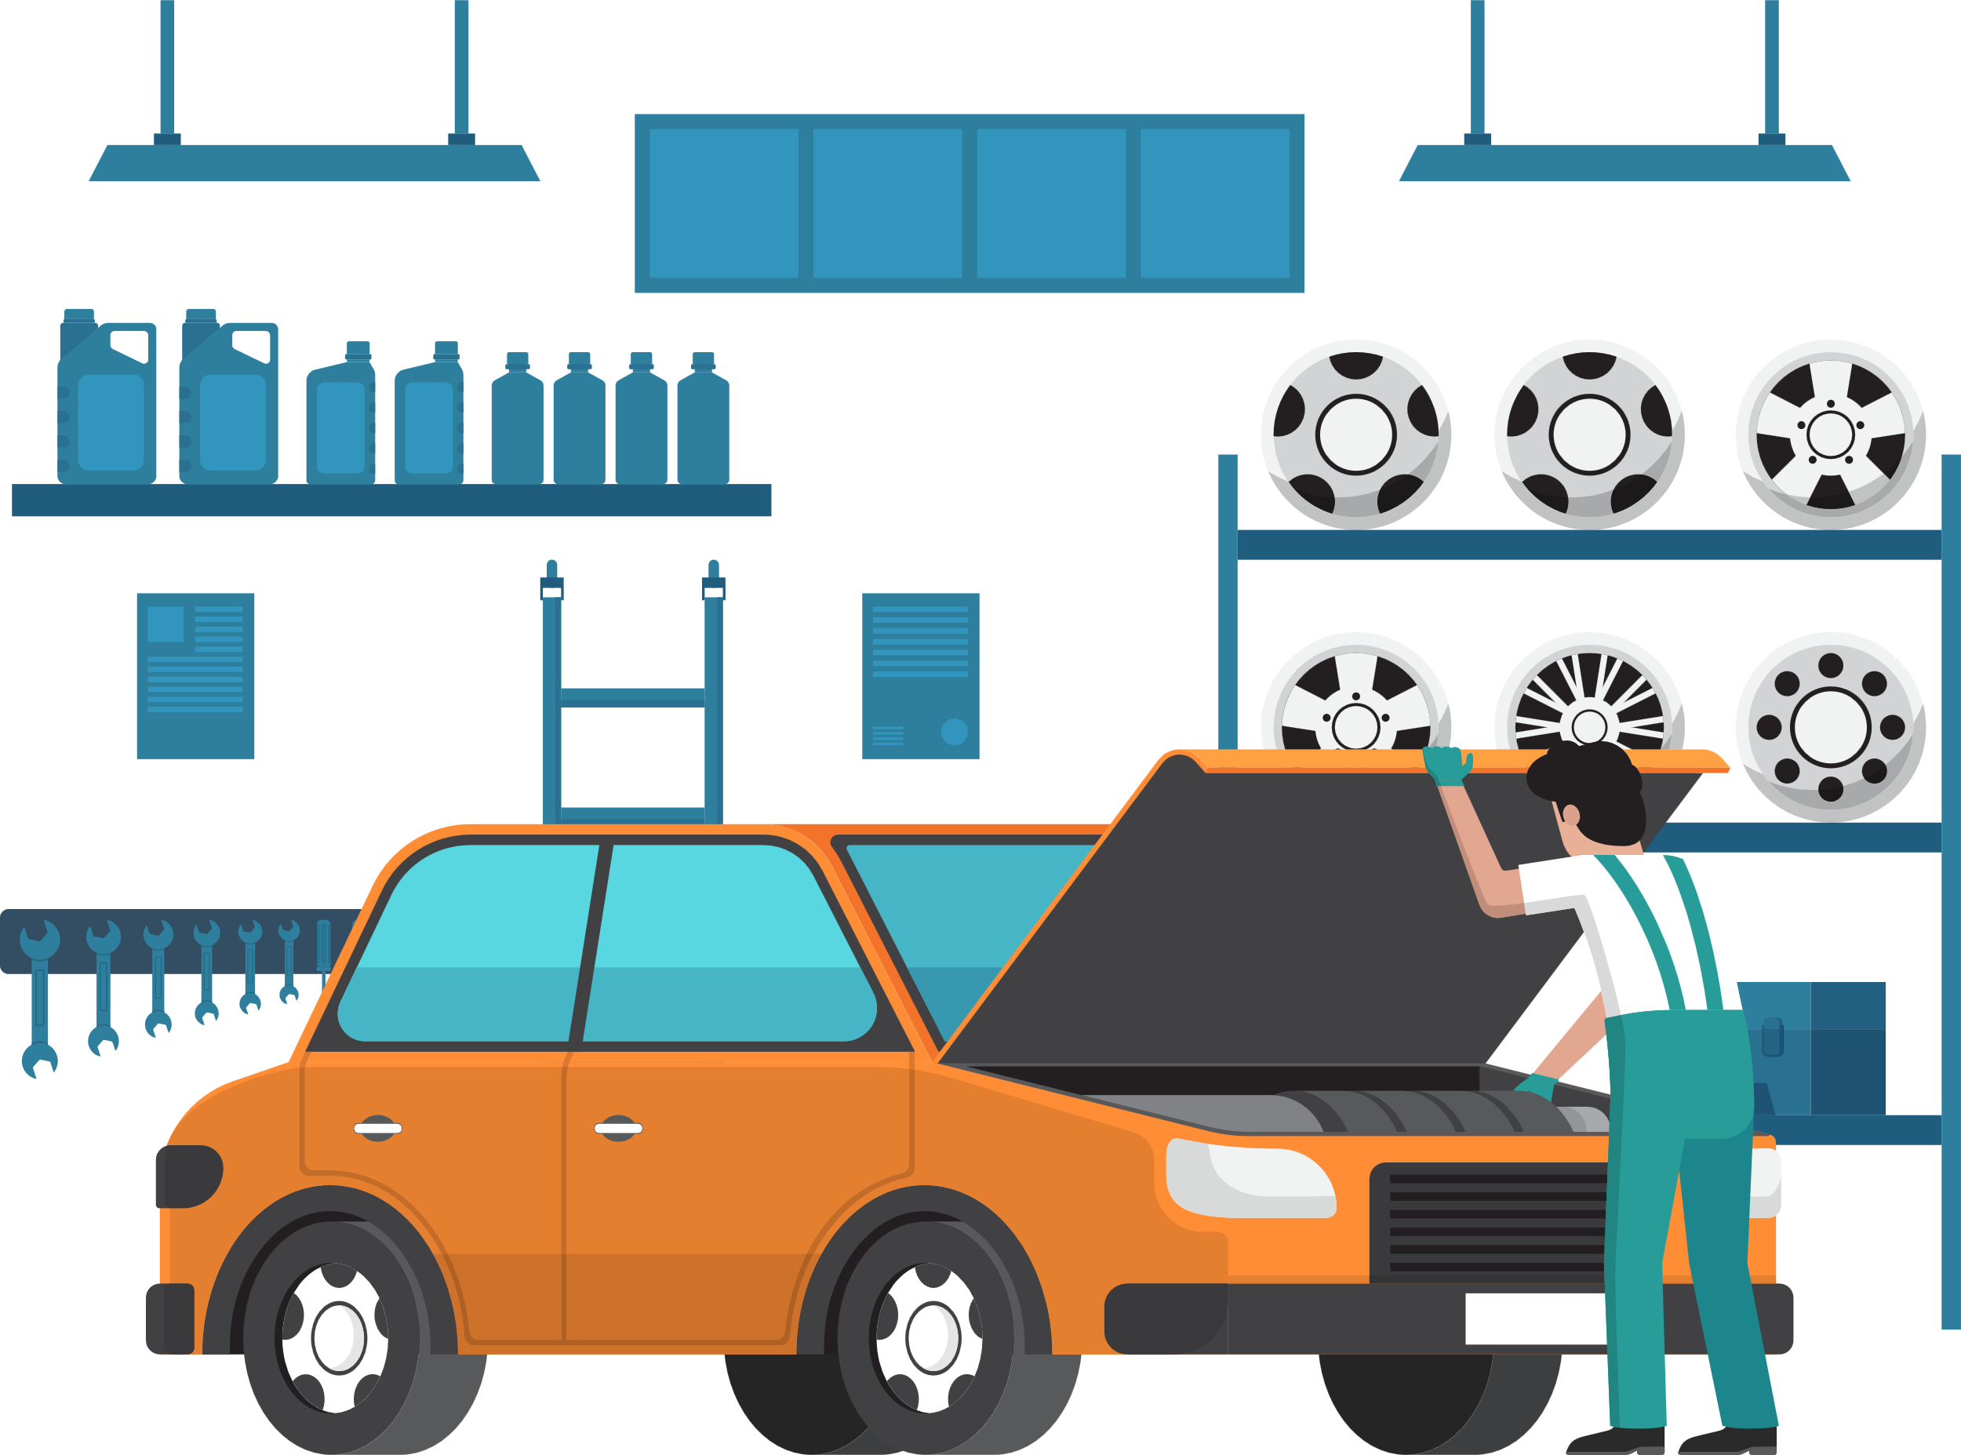
Driver Solution: Marketing Incentive on Driver
Bundling Promotion : Operation Flow
First time purchase
6 Months Product lifespan
Driver purchase
ExxonMobil's car lubricant
Driver register via QR code for
2nd purchase discount
Using Same QR code as MRW
Situation Analysis
Analysis Tool
Solution
Impact
3

Slide 46



Driver Solution: Marketing Incentive on Driver
Bundling Promotion : Operation Flow
Second time purchase
Driver comes to refill their
car’s lubricant at
Exxon-Registered Garage
Driver purchase
ExxonMobil's car lubricant
with discount
After
6 Months Product lifespan
Driver redeem their discount
through ExxonMobil’s LineOA/Website
Situation Analysis
Analysis Tool
Solution
Impact
4

Slide 47
Future Execution
Sales Uplift Prediction
Predict the incremental impact and Uplift Score of a specific action, typically a marketing campaign or promotional activity, on sales. (RFM Features Can be used)
Campaign Features
Product Features
Temporal Features
Campaign Details:
Channel, Content, Timing
Marketing Spend:
Budget Allocation, Cost per impression or acquisition.
Product Features
Price, Brand, Specifications, Product Category
Discounts and Promotions:
Discount Type, Promotion Duration.
Seasonality:
Time of Year: Seasonal trends, holidays, and events
Macro-Economic Indicators:
Unemployment rates, inflation, and consumer confidence.
Optimization: Adjust marketing strategies and resource allocation based on which actions drive the most uplift.
Targeting: Focus efforts on customer segments with the highest predicted uplift.
Evaluation: Assess the effectiveness of past campaigns to improve future ones.
Budgeting: Make informed decisions about marketing budgets based on expected returns.
Situation Analysis
Analysis Tool
Solution
Impact
5

Slide 48
Workshop & Retail Solution: Ranking System
RFM/Tier Analysis
Retail CLV Prediction
Tier | Precision | Recall | F1-Score
Low | 0.98 | 1.00 | 0.99
Mid | 1.00 | 0.94 | 0.97
High | 0.93 | 1.00 | 0.96
Accuracy | Accuracy | Accuracy | 0.98
Segment next month's Customer Tier and prepare appropriate rewards.
Feature Based on RFM Score
Recency
RecencyCluster
Frequency
FrequencyCluster
Monetary
MonetaryCluster
OverallScore (RFM Score)
Tier Segment (Target)
Model: XGBoost
Garage CLV Prediction
Tier | Precision | Recall | F1-Score
Low | 1.00 | 0.99 | 1.00
Mid | 0.98 | 1.00 | 0.99
High | 1.00 | 0.96 | 0.98
Accuracy | Accuracy | Accuracy | 0.99
*Future Advancement: Increased datasets and performed feature engineering to optimize clustering performance.
Model: XGBoost
Situation Analysis
Analysis Tool
Solution
Impact
6

Slide 49
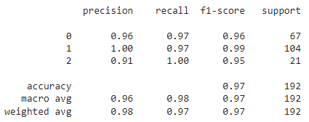
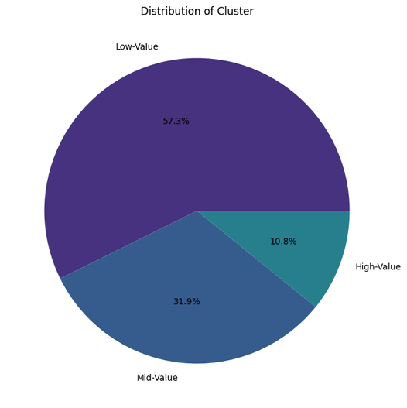
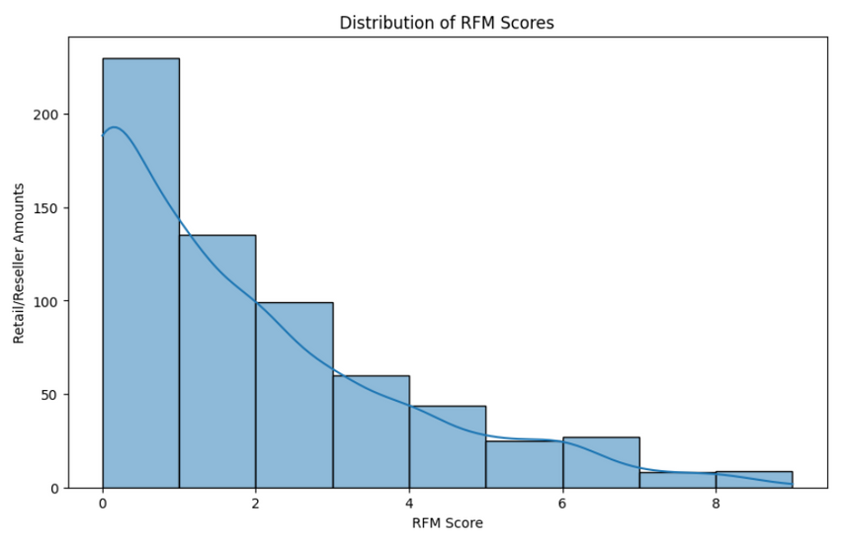
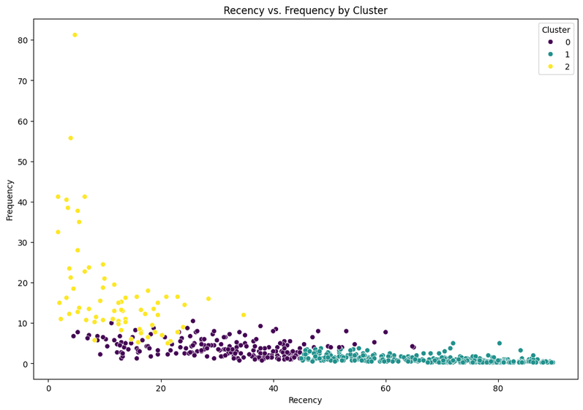
Retail/Reseller Customer Segment
7

Slide 50
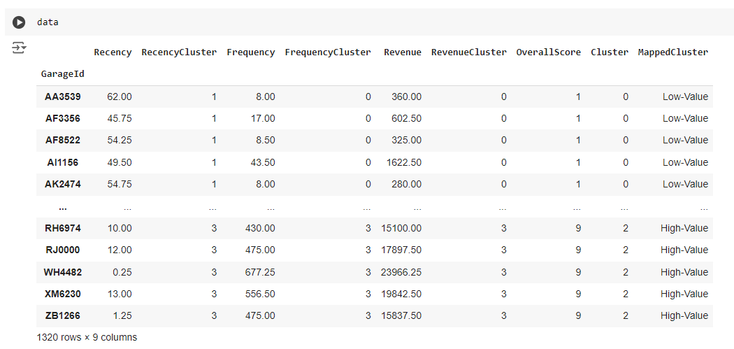
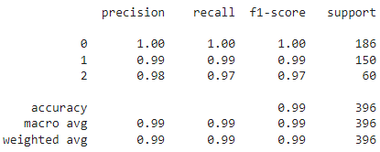
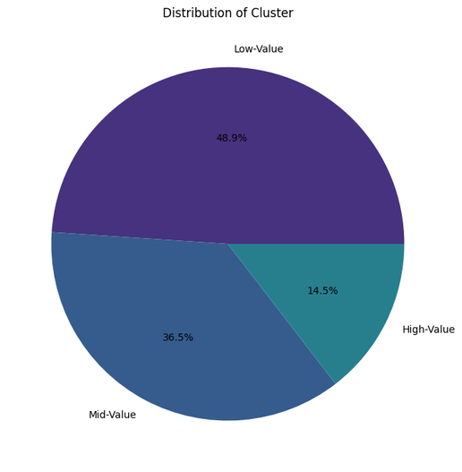
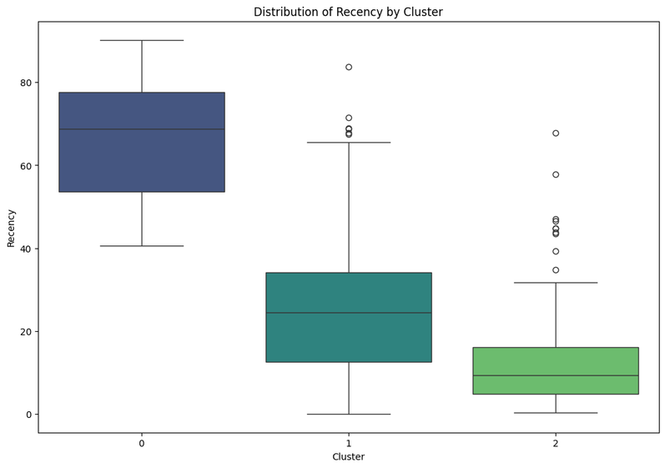
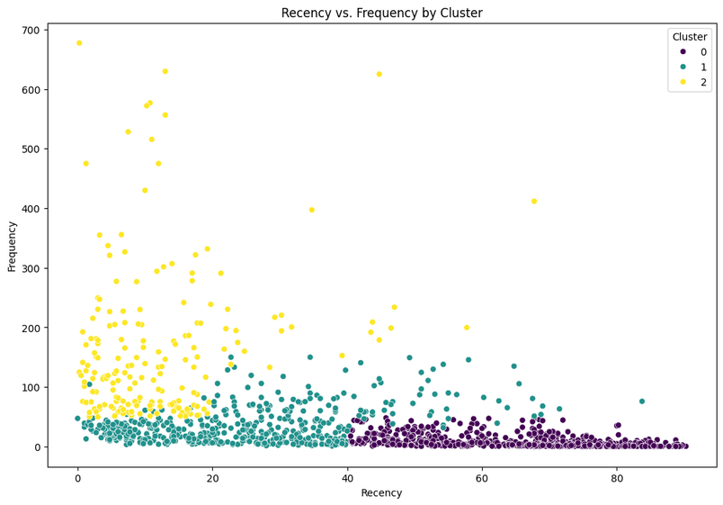
Garage Customer Segment
8

Slide 51
Workshop & Retail Solution: Churn Prevention
Churn Prediction
Predict Churn Customer and using Marketing Incentive on the Target.
Churn Prediction
Feature Based on RFM Score
Recency
Frequency
Monetary
OverallScore (RFM Score)
Average Transaction Time
Elapsed Time Since Latest Transaction
Churn Status (Target)
Performance
Sales variance between last month and this month is significant.
Sales trends over time
Churn_status | Precision | Recall | F1-Score
False | 0.81 | 0.91 | 0.85
True | 0.33 | 0.17 | 0.23
Accuracy | Accuracy | Accuracy | 0.76
+
Model: XGBoost
*Future Advancement: Increased datasets and performed feature engineering to optimize clustering performance.
Situation Analysis
Analysis Tool
Solution
Impact
9

Slide 52
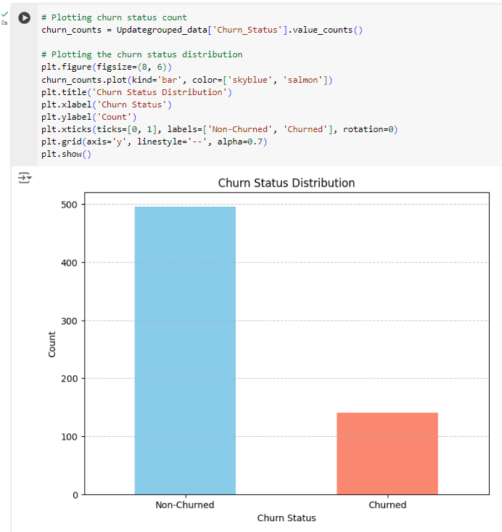
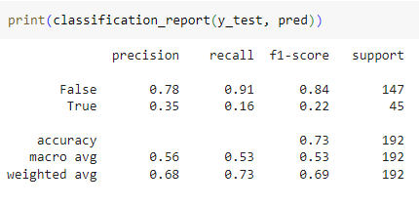
Retail Churn Prediction
10

